Slide 1
DCIT 212 NUMERICAL AND COMPUTATIONAL METHODS
Session 2 – Systems Of Linear Algebraic Equations - Part II
Lecturer: Justice K. Appati, PhD., UG, DCS
Contact Information: jkappati@ug.edu.gh

Slide 2
Course Information
Provide the following information:
Course Code: | DCIT 212
Course Title: | Numerical and Computational Methods
Course Credit | 3
Session Number & Session Title: | 2 & Systems Of Linear Algebraic Equations - Part II
Semester/Year: | 2 / 2021

Slide 3
Course Information (contd.)
Provide the following information:
Lecture Period(s) | 2
Prerequisites | DCIT 105: Mathematics for IT Professionals
Teaching Assistant | TBD

Slide 4
Course Instructor’s Contact
Provide the following information:
Course Instructor(s) Name | Justice K. Appati, PhD.
Office Location | Stat 010, Statistics Building
Office Hours | TBD
Phone | N/A
E-mail | jkappati@ug.edu.gh

Slide 5
Session Overview
This session is a continuation of session 1. In the session we look at tridiagonal systems of equations. Iterative methods such as Jacobi, Gauss-Seidel and SOR are also explored and used to evaluate systems of linear equations. The pitfall of these methods is also treated

Slide 6
Session Outline
Tridiagonal Systems of Equations
Pitfalls of Elimination Methods
Jacobi Iteration Method and Convergence
Gauss-Seidel Iteration Method
Successive-Over-Relaxation Method

Slide 7
Learning Objectives
After completing this session, you will be able to:
Understand and solve tridiagonal systems of equations.
Explain the pitfalls of elimination methods.
Estimate the norms and condition number
Evaluate systems using Jacobi method
Evaluate systems using Gauss-Seidel and SOR method

Slide 8
Session Activities and Assignments
This week, complete the following tasks:
Log onto the UG Sakai LMS course site: http://sakai.ug.edu.gh/
Read Chapter 1 (Pages 49-67) of the Recommended Textbook – Joe D. Hoffman (2001), Numerical Methods for Engineers and Scientists (2nd Edition).
Review Lecture Slides: Session 2 – Systems Of Linear Algebraic Equations - Part II
Visit the Chat Room and discuss the Forum question for Session 2
Complete the Individual Assignment for Session 2

Slide 9
Reading List
Read Chapter 1 (Pages 49-67) of the Recommended Textbook – Joe D. Hoffman (2001), Numerical Methods for Engineers and Scientists (2nd Edition).

Slide 10
TriDIAGONAL SYSTEMS Of EQUATIONS
Topic One

Slide 11
Tridiagonal Systems of Equations
When a large system of linear algebraic equations has a special pattern such as a tridiagonal pattern, it is usually worthwhile to develop special methods for that unique pattern.
There are a number of direct elimination methods for solving systems of linear algebraic equations which have special patterns in the coefficient matrix.
These methods are generally very efficient in computer time and storage.
One algorithm that deserves special attention is the algorithm for tridiagonal matrices often refers to as the Thomas algorithm

Slide 12
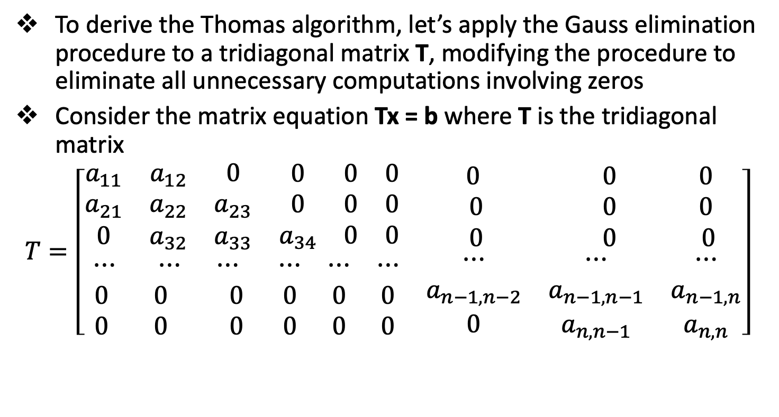
Tridiagonal Systems of Equations
To derive the Thomas algorithm, let’s apply the Gauss elimination procedure to a tridiagonal matrix T, modifying the procedure to eliminate all unnecessary computations involving zeros
Consider the matrix equation Tx = b where T is the tridiagonal matrix
$$T=\left[\begin{matrix}\begin{matrix}a_{11} & a_{12} & 0 \\ a_{21} & a_{22} & a_{23} \\ 0 & a_{32} & a_{33}\end{matrix} & \begin{matrix}0 & 0 & 0 \\ 0 & 0 & 0 \\ a_{34} & 0 & 0\end{matrix} & \begin{matrix}0 & 0 & 0 \\ 0 & 0 & 0 \\ 0 & 0 & 0\end{matrix} \\ \begin{matrix}⋯ & ⋯ & ⋯ \\ 0 & 0 & 0 \\ 0 & 0 & 0\end{matrix} & \begin{matrix}⋯ & ⋯ & ⋯ \\ 0 & 0 & 0 \\ 0 & 0 & 0\end{matrix} & \begin{matrix}⋯ & ⋯ & ⋯ \\ a_{n−1,n−2} & a_{n−1,n−1} & a_{n−1,n} \\ 0 & a_{n,n−1} & a_{n,n}\end{matrix}\end{matrix}\right]$$

Slide 13
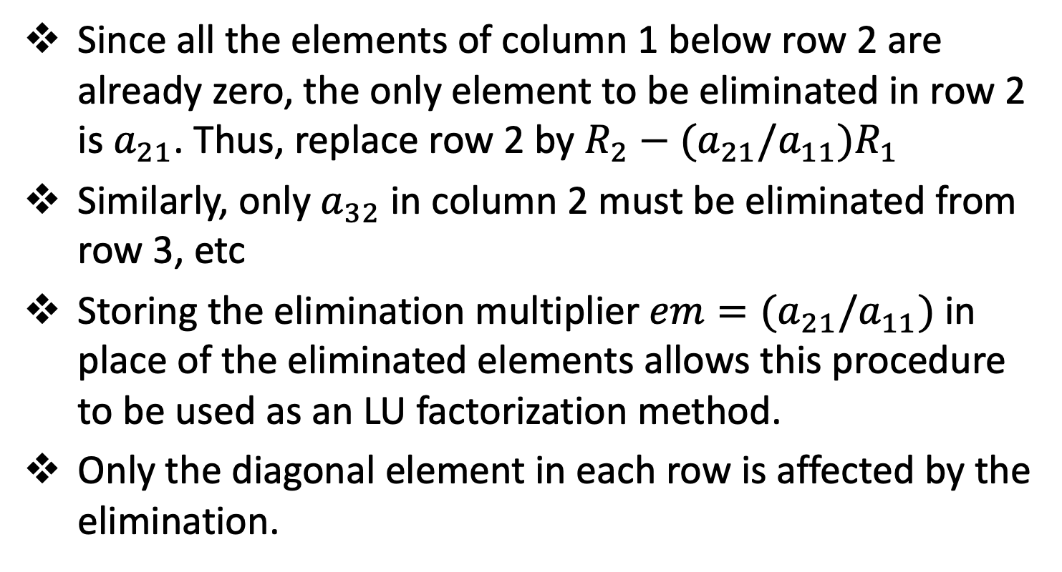
Tridiagonal Systems of Equations
Since all the elements of column 1 below row 2 are already zero, the only element to be eliminated in row 2 is $a_{21}$. Thus, replace row 2 by ${R_{2}−(a}_{21}/a_{11})R_{1}$
Similarly, only $a_{32}$ in column 2 must be eliminated from row 3, etc
Storing the elimination multiplier $em=(a_{21}/a_{11})$ in place of the eliminated elements allows this procedure to be used as an LU factorization method.
Only the diagonal element in each row is affected by the elimination.

Slide 14
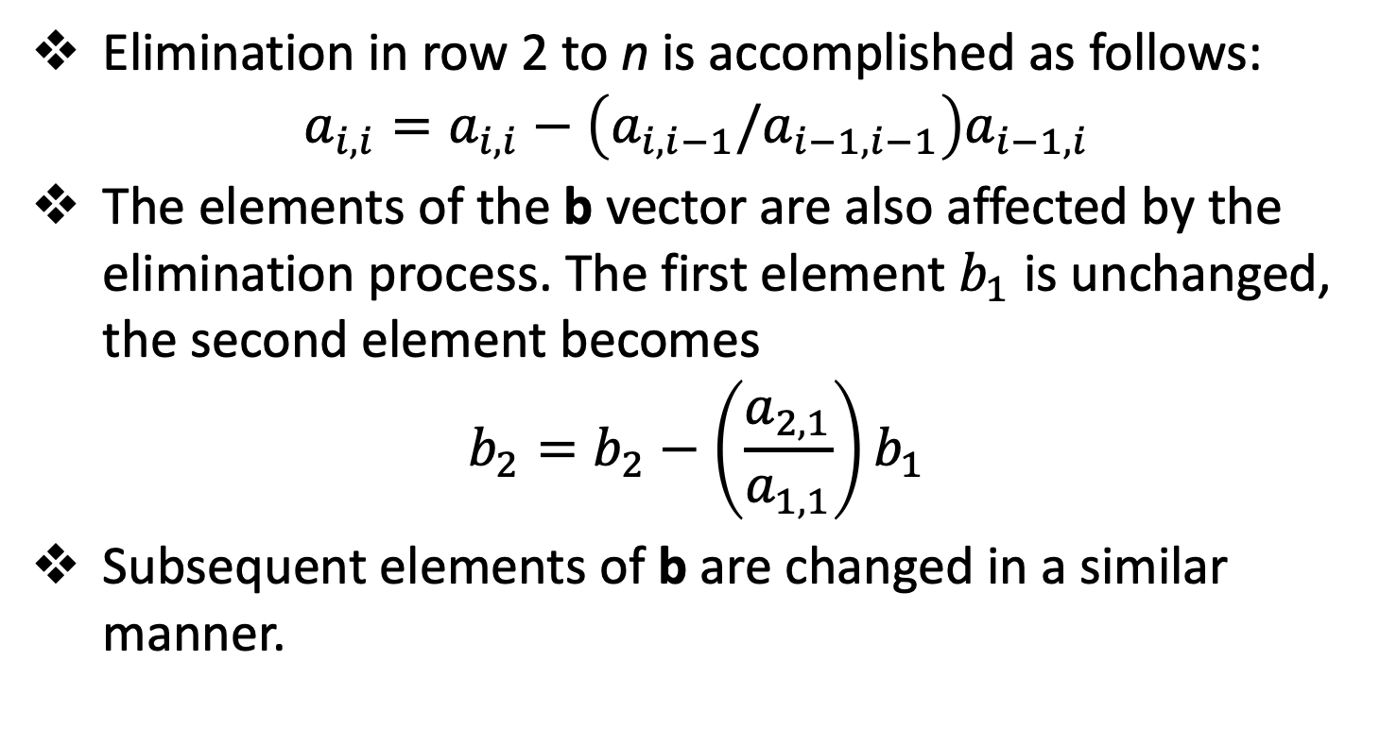
Tridiagonal Systems of Equations
Elimination in row 2 to n is accomplished as follows:
$$a_{i,i}=a_{i,i}−\left(a_{i,i−1}/a_{i−1,i−1}\right)a_{i−1,i}$$
The elements of the b vector are also affected by the elimination process. The first element $b_{1}$ is unchanged, the second element becomes
$$b_{2}=b_{2}−\left(\frac{a_{2,1}}{a_{1,1}}\right)b_{1}$$
Subsequent elements of b are changed in a similar manner.

Slide 15
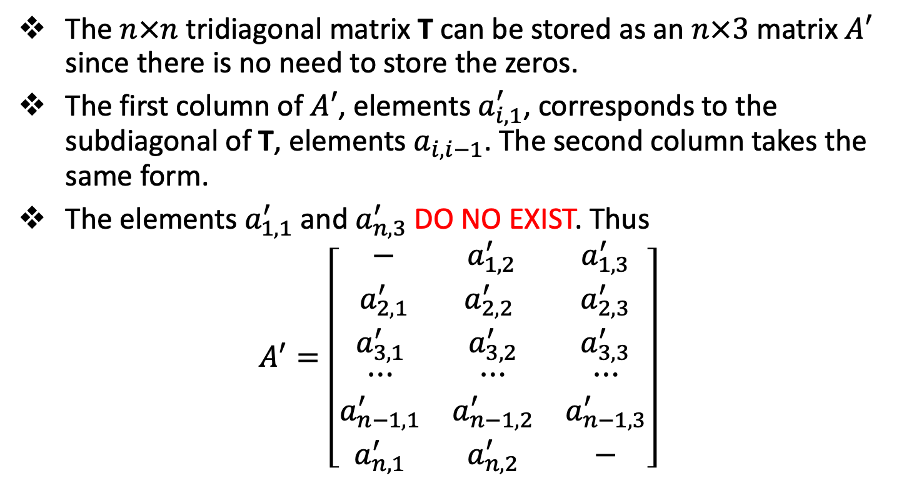
Tridiagonal Systems of Equations
The $n×n$ tridiagonal matrix T can be stored as an $n×3$ matrix $A′$ since there is no need to store the zeros.
The first column of $A′$, elements $a_{i,1}^{′}$, corresponds to the subdiagonal of T, elements $a_{i,i−1}$. The second column takes the same form.
The elements $a_{1,1}^{′}$ and $a_{n,3}^{′}$ DO NO EXIST. Thus
$$A^{′}=\left[\begin{matrix}\begin{matrix}− & a_{1,2 }^{′} & a_{1,3}^{′} \\ a_{2,1 }^{′} & a_{2,2 }^{′} & a_{2,3}^{′} \\ a_{3,1}^{′} & a_{3,2}^{′} & a_{3,3}^{′}\end{matrix} \\ \begin{matrix}⋯ & ⋯ & ⋯ \\ a_{n−1,1}^{′} & a_{n−1,2}^{′} & a_{n−1,3}^{′} \\ a_{n,1}^{′} & a_{n,2}^{′} & −\end{matrix}\end{matrix}\right]$$

Slide 16
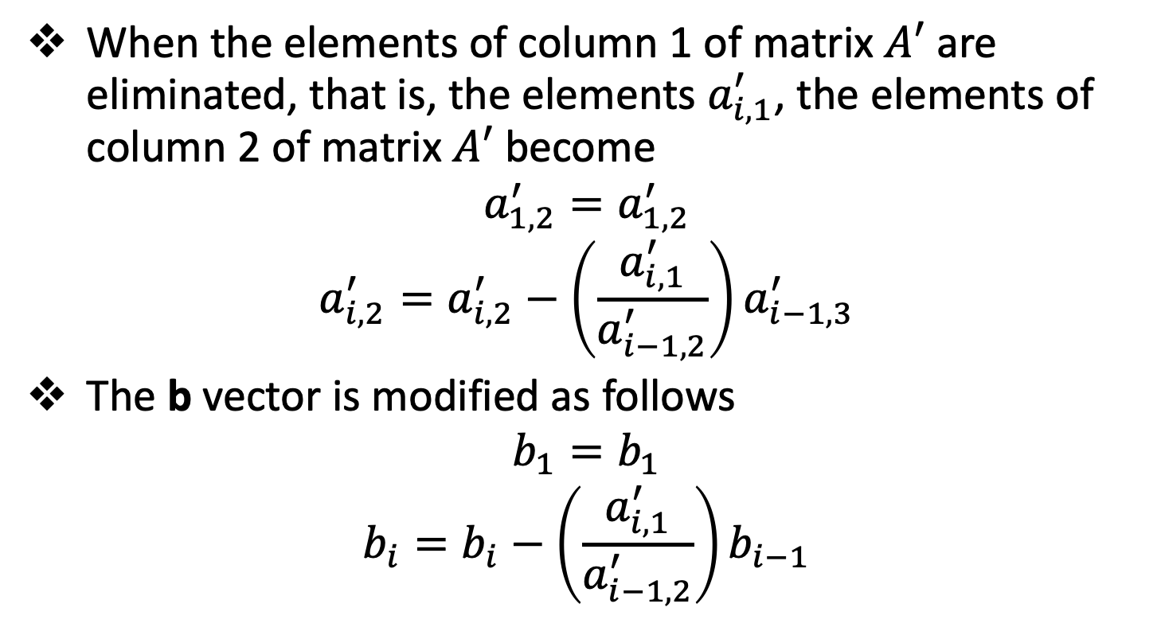
Tridiagonal Systems of Equations
When the elements of column 1 of matrix $A′$ are eliminated, that is, the elements $a_{i,1}^{′}$, the elements of column 2 of matrix $A′$ become
$$a_{1,2}^{′}=a_{1,2}^{′}$$
$$a_{i,2}^{′}=a_{i,2}^{′}−\left(\frac{a_{i,1}^{′}}{a_{i−1,2}^{′}}\right)a_{i−1,3}^{′}$$
The b vector is modified as follows
$$b_{1}=b_{1}$$
$$b_{i}=b_{i}−\left(\frac{a_{i,1}^{′}}{a_{i−1,2}^{′}}\right)b_{i−1}$$

Slide 17
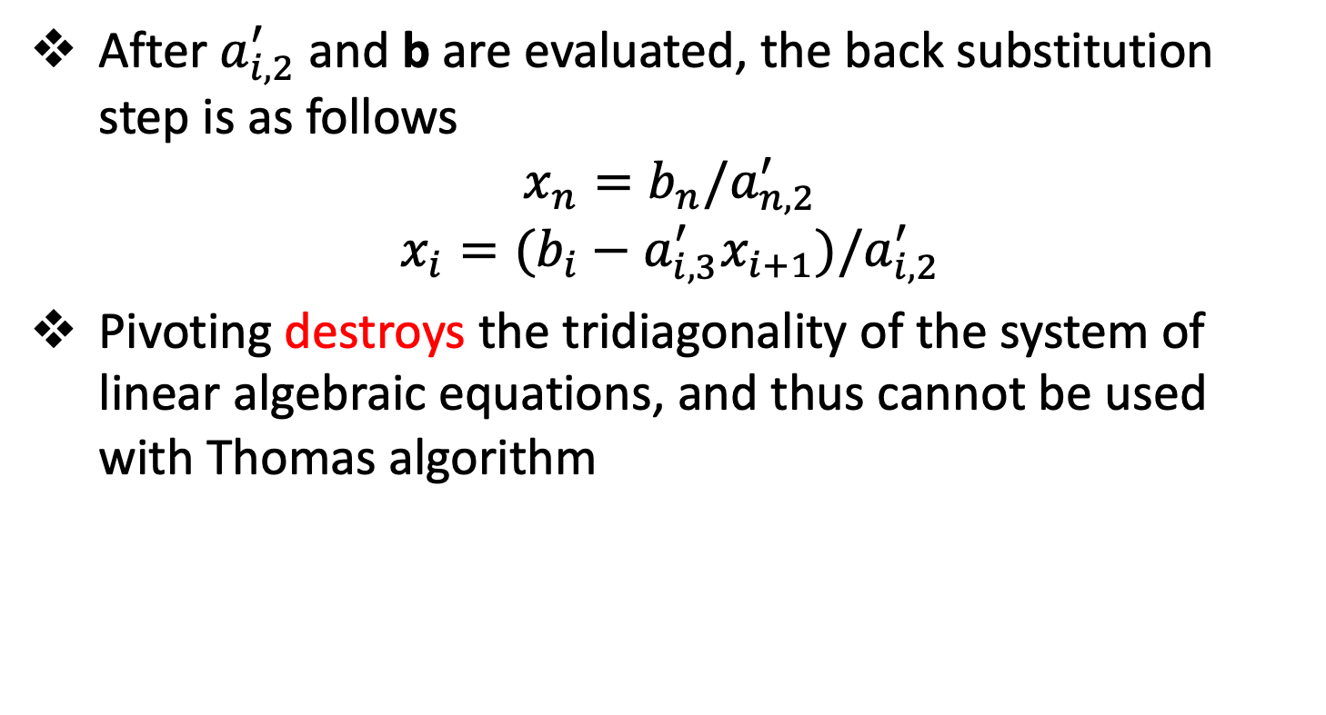
Tridiagonal Systems of Equations
After $a_{i,2}^{′}$ and b are evaluated, the back substitution step is as follows
$$x_{n}=b_{n}/a_{n,2}^{′}$$
$$x_{i}=(b_{i}−a_{i,3}^{′}x_{i+1})/a_{i,2}^{′}$$
Pivoting destroys the tridiagonality of the system of linear algebraic equations, and thus cannot be used with Thomas algorithm

Slide 18
Pitfalls of elimination methods
Topic Two

Slide 19
Introduction
All nonsingular systems of linear algebraic equations have a solution. In theory, the solution can always be obtained by Gauss elimination
However, there are two major pitfalls in the application of Gauss elimination
the presence of round-off errors
ill-conditioned systems
The effects of round-off can be reduced by a procedure known as iterative improvement.

Slide 20
Round-Off Errors
Round-off errors occur when exact infinite precision numbers are approximated by finite precision numbers.
In most computers, single precision representation of numbers typically contains about 7 significant digits, double precision representation typically contains about 14 significant digits and quad precision representation typically contains about 28 significant digits.
Round-off error can never be completely eliminated; however, they can be minimized by using high precision arithmetic and pivoting

Slide 21
System Condition
All well posed nonsingular numerical problems have an exact solution. In theory, the exact solution can always be obtained using fractions or infinite precision numbers.
However, all practical calculations are done with finite precision numbers which necessarily contain round-off errors. The presence of round-off errors alters the solution to the problem.
A well-conditioned problem is one in which a small change in any of the elements of the problem causes only a small change in the solution of the problem.

Slide 22
System Condition
An ill-conditioned problem is one in which a small change in any elements of the problem causes a large change in the solution of the problem.
Since ill-conditioned systems are extremely sensitive to small changes in the elements of the problem, they are also extremely sensitive to round-off errors.
There are several ways to check a matrix A for ill-conditioning. If the magnitude of the determinant of the matrix is small, the matrix may be ill-conditioned. (NB: This is not a foolproof test)

Slide 23
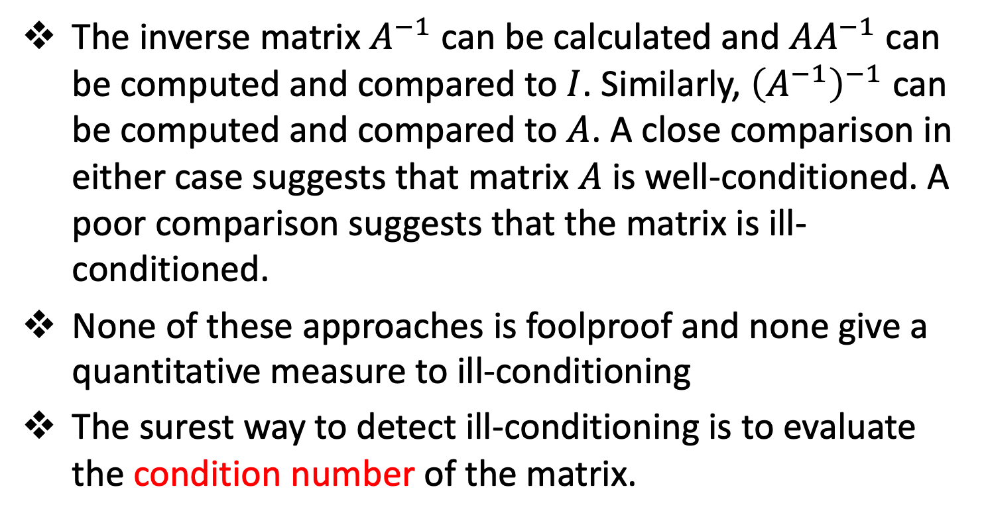
System Condition
The inverse matrix $A^{−1}$ can be calculated and $AA^{−1}$ can be computed and compared to $I$. Similarly, ${\left(A^{−1}\right)}^{−1}$ can be computed and compared to $A$. A close comparison in either case suggests that matrix $A$ is well-conditioned. A poor comparison suggests that the matrix is ill-conditioned.
None of these approaches is foolproof and none give a quantitative measure to ill-conditioning
The surest way to detect ill-conditioning is to evaluate the condition number of the matrix.

Slide 24
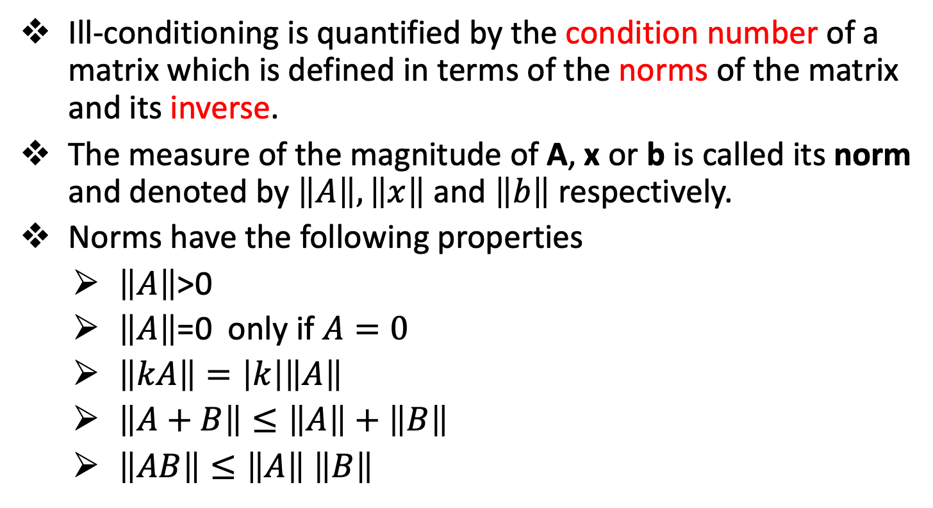
Norms and Condition Number - Norms
Ill-conditioning is quantified by the condition number of a matrix which is defined in terms of the norms of the matrix and its inverse.
The measure of the magnitude of A, x or b is called its norm and denoted by $\left\|A\right\|,\left\|x\right\|$ and $\left\|b\right\|$ respectively.
Norms have the following properties
$\left\|A\right\|$>0
$\left\|A\right\|$=0 only if $A=0$
$\left\|kA\right\|=\left|k\right|\left\|A\right\|$
$\left\|A+B\right\|≤\left\|A\right\|+\left\|B\right\|$
$\left\|AB\right\|≤\left\|A\right\|$ $\left\|B\right\|$

Slide 25
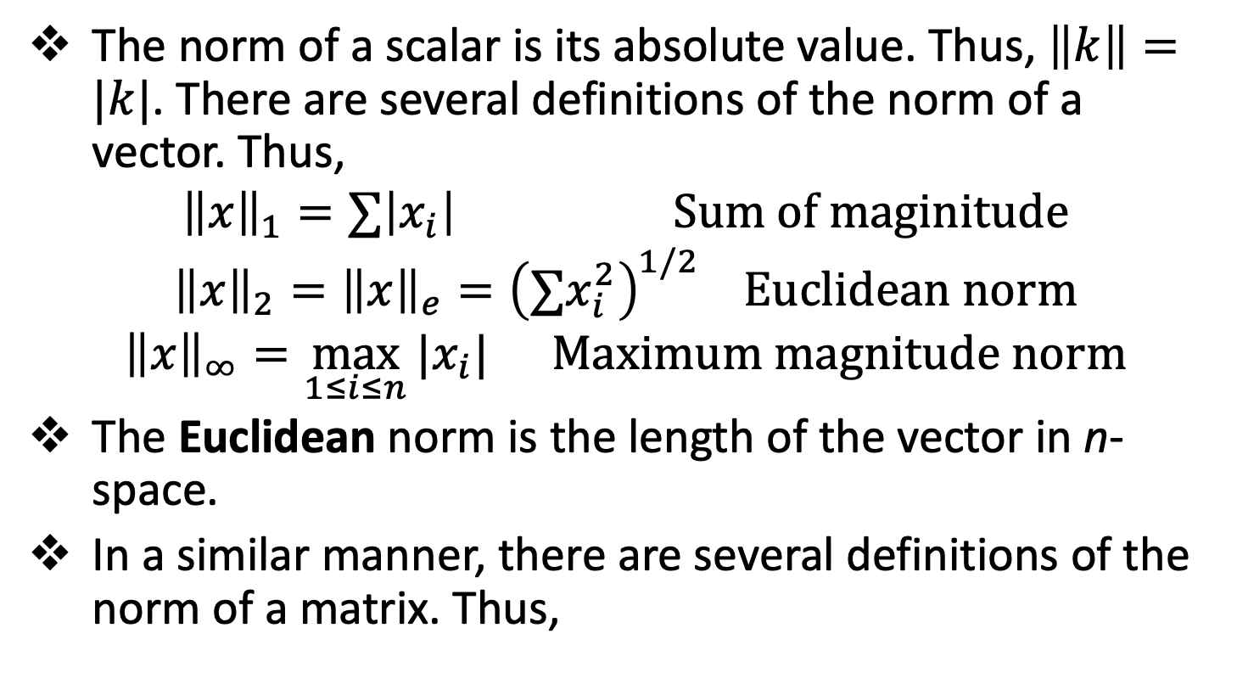
Norms and Condition Number - Norms
The norm of a scalar is its absolute value. Thus, $\left\|k\right\|=|k|$. There are several definitions of the norm of a vector. Thus,
$${\left\|x\right\|}_{1}=∑\left|x_{i}\right| Sum of maginitude$$
$${\left\|x\right\|}_{2}={\left\|x\right\|}_{e}={\left(∑x_{i}^{2}\right)}^{1/2} Euclidean norm$$
$${\left\|x\right\|}_{∞}=\max_{1≤i≤n}{|x_{i}|} Maximum magnitude norm$$
The Euclidean norm is the length of the vector in n-space.
In a similar manner, there are several definitions of the norm of a matrix. Thus,

Slide 26
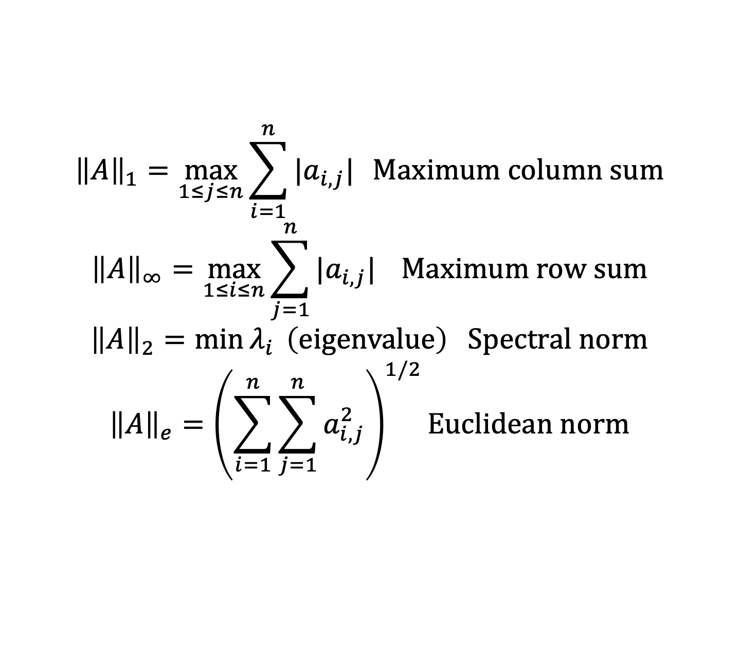
Norms and Condition Number - Norms
$${\left\|A\right\|}_{1}=\max_{1≤j≤n}{\sum_{i=1}^{n}{|a_{i,j}|}} Maximum column sum$$
$${\left\|A\right\|}_{∞}=\max_{1≤i≤n}{\sum_{j=1}^{n}{|a_{i,j}|}} Maximum row sum$$
$${\left\|A\right\|}_{2}=\min{λ_{i}} \left(eigenvalue\right) Spectral norm$$
$${\left\|A\right\|}_{e}={\left(\sum_{i=1}^{n}{\sum_{j=1}^{n}{a_{i,j}^{2}}}\right)}^{1/2}Euclidean norm$$

Slide 27
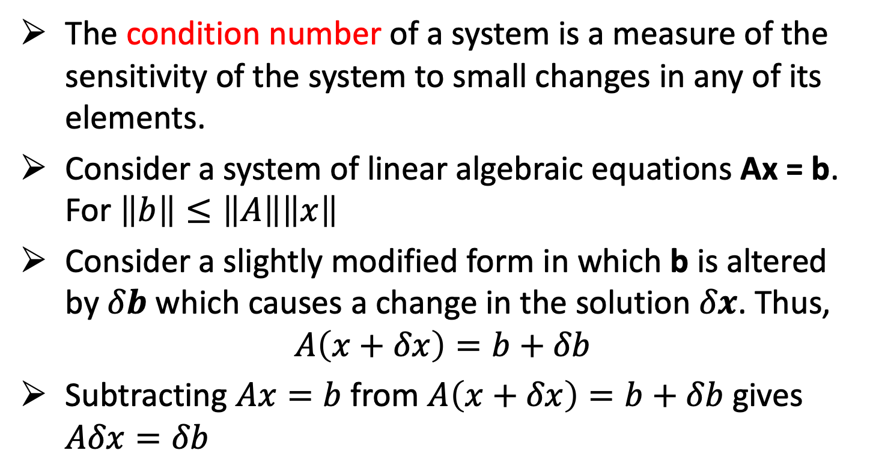
Norms and Condition Number – Condition Number
The condition number of a system is a measure of the sensitivity of the system to small changes in any of its elements.
Consider a system of linear algebraic equations Ax = b. For $\left\|b\right\|≤\left\|A\right\|\left\|x\right\|$
Consider a slightly modified form in which b is altered by $δb$ which causes a change in the solution $δx$. Thus,
$$A\left(x+δx\right)=b+δb$$
Subtracting $Ax=b$ from $A\left(x+δx\right)=b+δb$ gives $Aδx=δb$

Slide 28
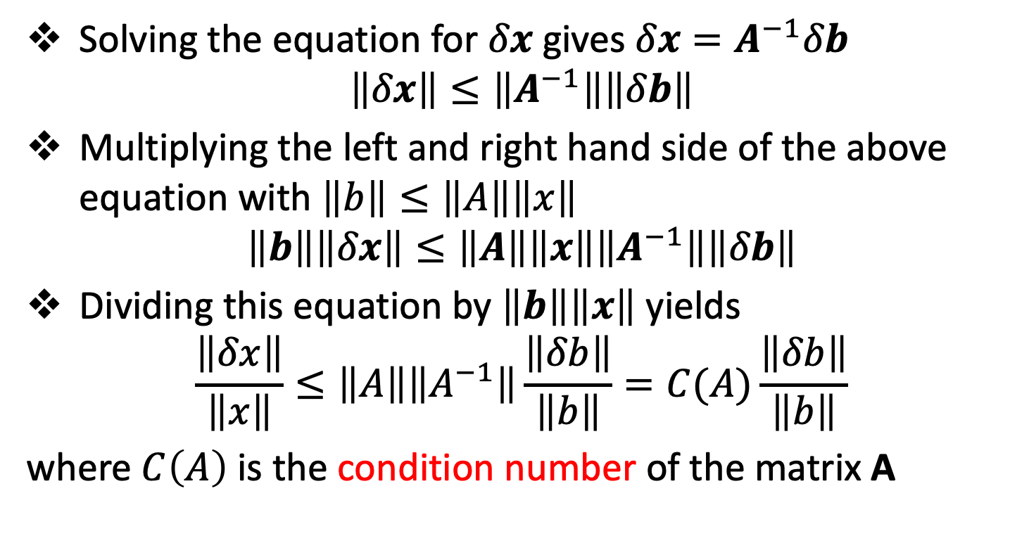
Norms and Condition Number – Condition Number
Solving the equation for $δx$ gives $δx=A^{−1}δb$
$$\left\|δx\right\|≤\left\|A^{−1}\right\|\left\|δb\right\|$$
Multiplying the left and right hand side of the above equation with $\left\|b\right\|≤\left\|A\right\|\left\|x\right\|$
$$\left\|b\right\|\left\|δx\right\|≤\left\|A\right\|\left\|x\right\|\left\|A^{−1}\right\|\left\|δb\right\|$$
Dividing this equation by $\left\|b\right\|\left\|x\right\|$ yields
$$\frac{\left\|δx\right\|}{\left\|x\right\|}≤\left\|A\right\|\left\|A^{−1}\right\|\frac{\left\|δb\right\|}{\left\|b\right\|}=C(A)\frac{\left\|δb\right\|}{\left\|b\right\|}$$
where $C\left(A\right)$ is the condition number of the matrix A

Slide 29
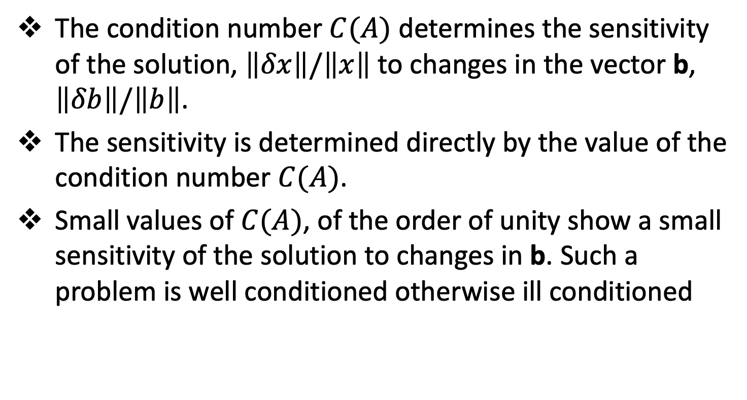
Norms and Condition Number – Condition Number
The condition number $C(A)$ determines the sensitivity of the solution, $\left\|δx\right\|/\left\|x\right\|$ to changes in the vector b, $\left\|δb\right\|/\left\|b\right\|$.
The sensitivity is determined directly by the value of the condition number $C(A)$.
Small values of $C(A)$, of the order of unity show a small sensitivity of the solution to changes in b. Such a problem is well conditioned otherwise ill conditioned

Slide 30
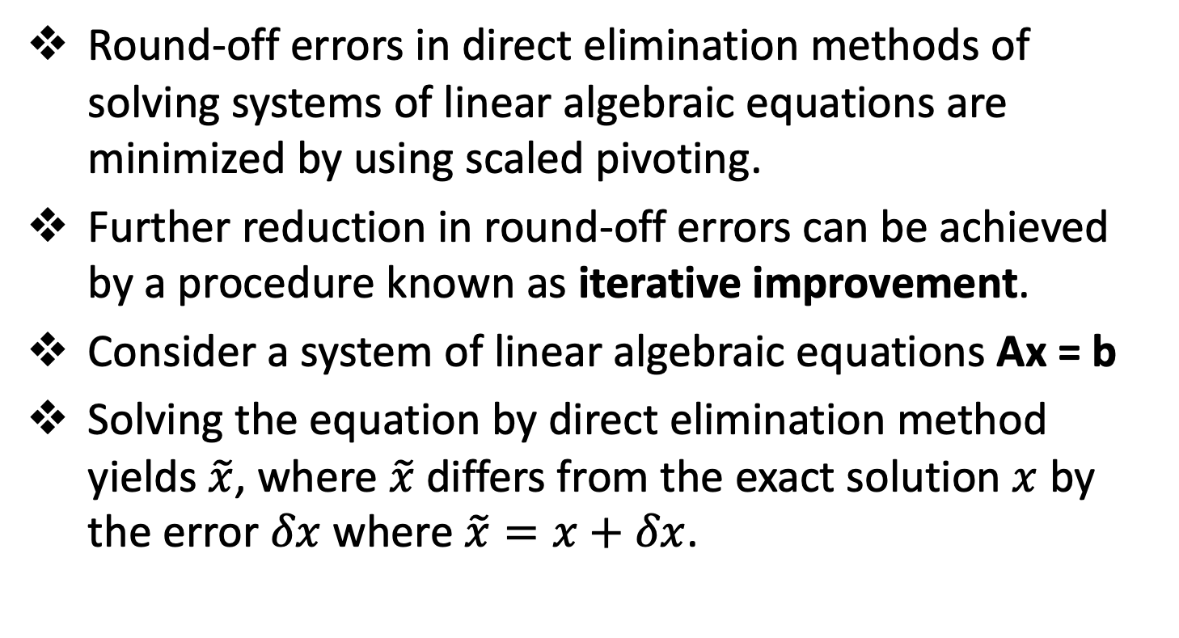
Norms and Condition Number – Iterative Improvement
Round-off errors in direct elimination methods of solving systems of linear algebraic equations are minimized by using scaled pivoting.
Further reduction in round-off errors can be achieved by a procedure known as iterative improvement.
Consider a system of linear algebraic equations Ax = b
Solving the equation by direct elimination method yields $\tilde{x}$, where $\tilde{x}$ differs from the exact solution $x$ by the error $δx$ where $\tilde{x}=x+δx$.

Slide 31
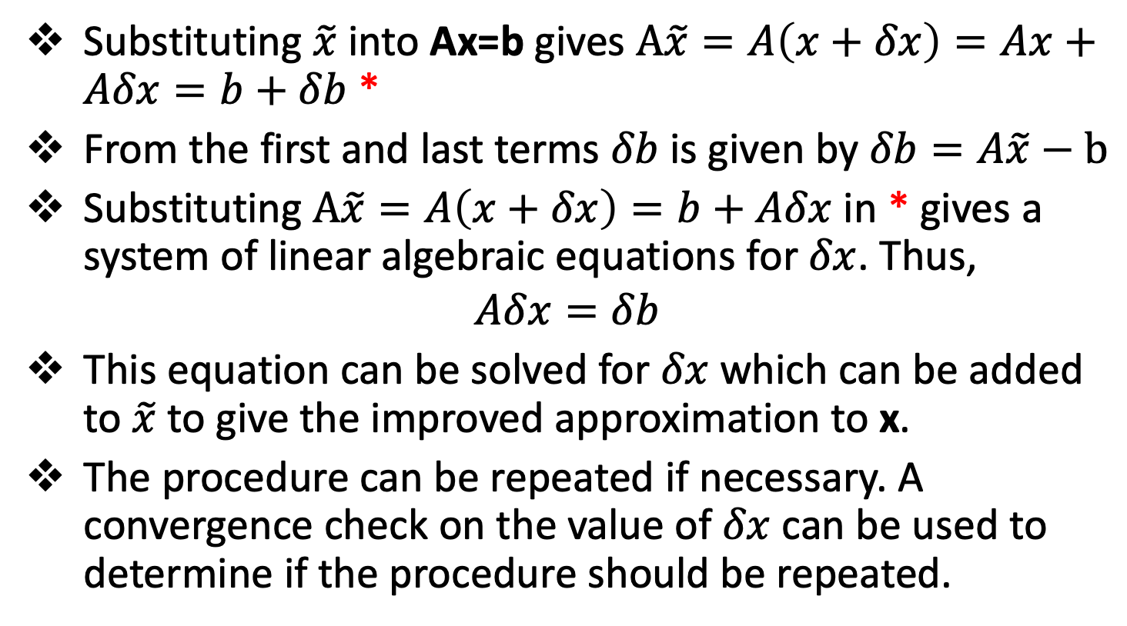
Norms and Condition Number – Iterative Improvement
Substituting $\tilde{x}$ into Ax=b gives $A\tilde{x}=A\left(x+δx\right)=Ax+Aδx=b+δb$ *
From the first and last terms $δb$ is given by $δb=A\tilde{x}−b$
Substituting $A\tilde{x}=A\left(x+δx\right)=b+Aδx$ in * gives a system of linear algebraic equations for $δx$. Thus,
$$Aδx=δb$$
This equation can be solved for $δx$ which can be added to $\tilde{x}$ to give the improved approximation to x.
The procedure can be repeated if necessary. A convergence check on the value of $δx$ can be used to determine if the procedure should be repeated.

Slide 32
Iterative methods
Topic Three

Slide 33
Introduction
For many large systems of linear algebraic equations, Ax=b, the coefficient matrix A is extremely sparce.
If the matrix is diagonally dominant, it is generally more efficient to solve such systems of linear algebraic equations by iterative methods than by direct elimination methods.
Three iterative methods are presented in this section:
Jacobi iteration
Gauss-Seidel iteration
Successive-over-relaxation (SOR)

Slide 34
Introduction
The number of iterations required to achieve convergence depends on:
The dominance of the diagonal coefficient. As the diagonal dominance increases, the number of iterations required to satisfy the convergence criterion decreases.
The method of iteration used
The initial solution vector
The convergence criterion specified

Slide 35
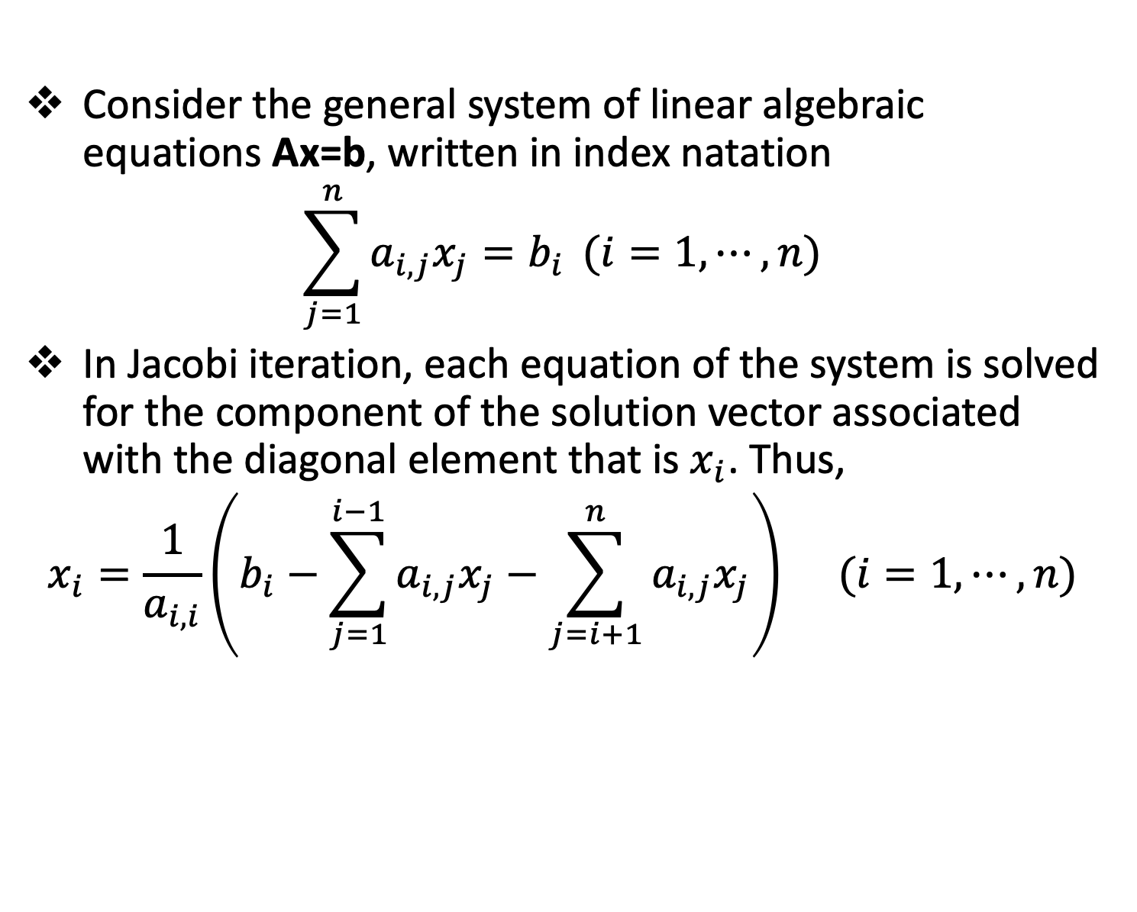
The Jacobi Iteration Method
Consider the general system of linear algebraic equations Ax=b, written in index natation
$$\sum_{j=1}^{n}{a_{i,j}x_{j}=b_{i}} (i=1,⋯,n)$$
In Jacobi iteration, each equation of the system is solved for the component of the solution vector associated with the diagonal element that is $x_{i}$. Thus,
$$x_{i}=\frac{1}{a_{i,i}}\left(b_{i}−\sum_{j=1}^{i−1}{a_{i,j}x_{j}}−\sum_{j=i+1}^{n}{a_{i,j}x_{j}}\right) (i=1,⋯,n)$$

Slide 36
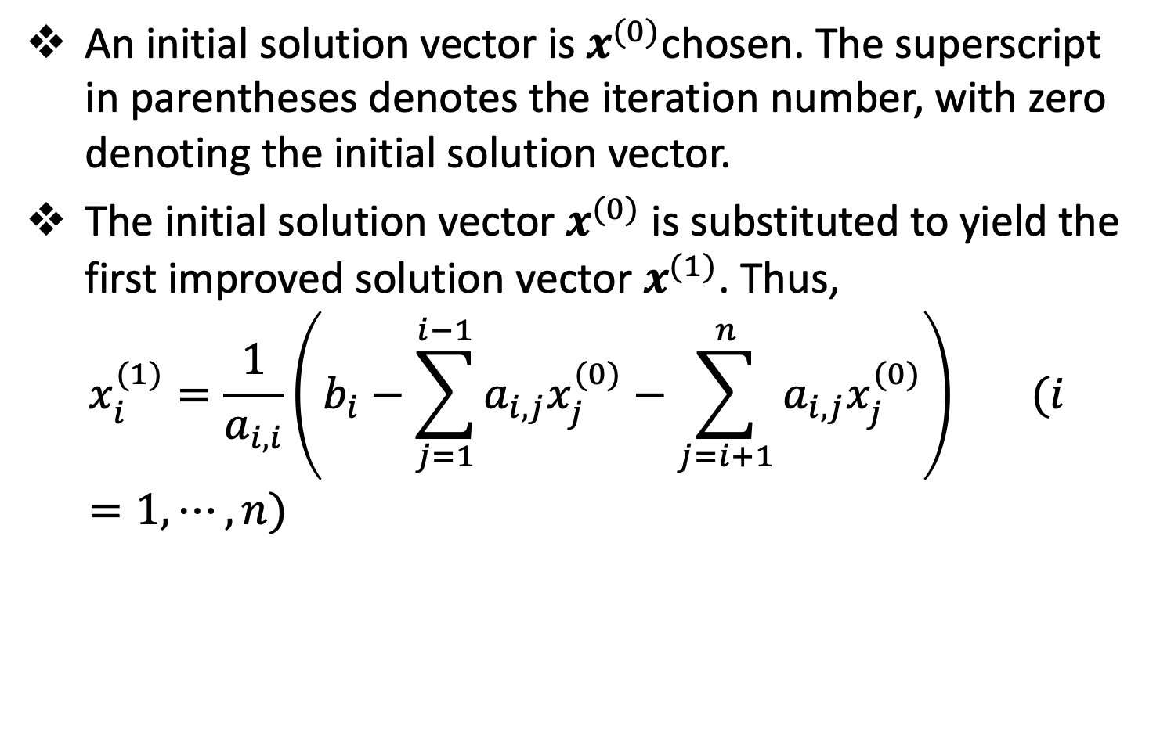
The Jacobi Iteration Method
An initial solution vector is $x^{(0)}$chosen. The superscript in parentheses denotes the iteration number, with zero denoting the initial solution vector.
The initial solution vector $x^{(0)}$ is substituted to yield the first improved solution vector $x^{(1)}$. Thus,
$$x_{i}^{(1)}=\frac{1}{a_{i,i}}\left(b_{i}−\sum_{j=1}^{i−1}{a_{i,j}x_{j}^{(0)}}−\sum_{j=i+1}^{n}{a_{i,j}x_{j}^{(0)}}\right) (i=1,⋯,n)$$

Slide 37
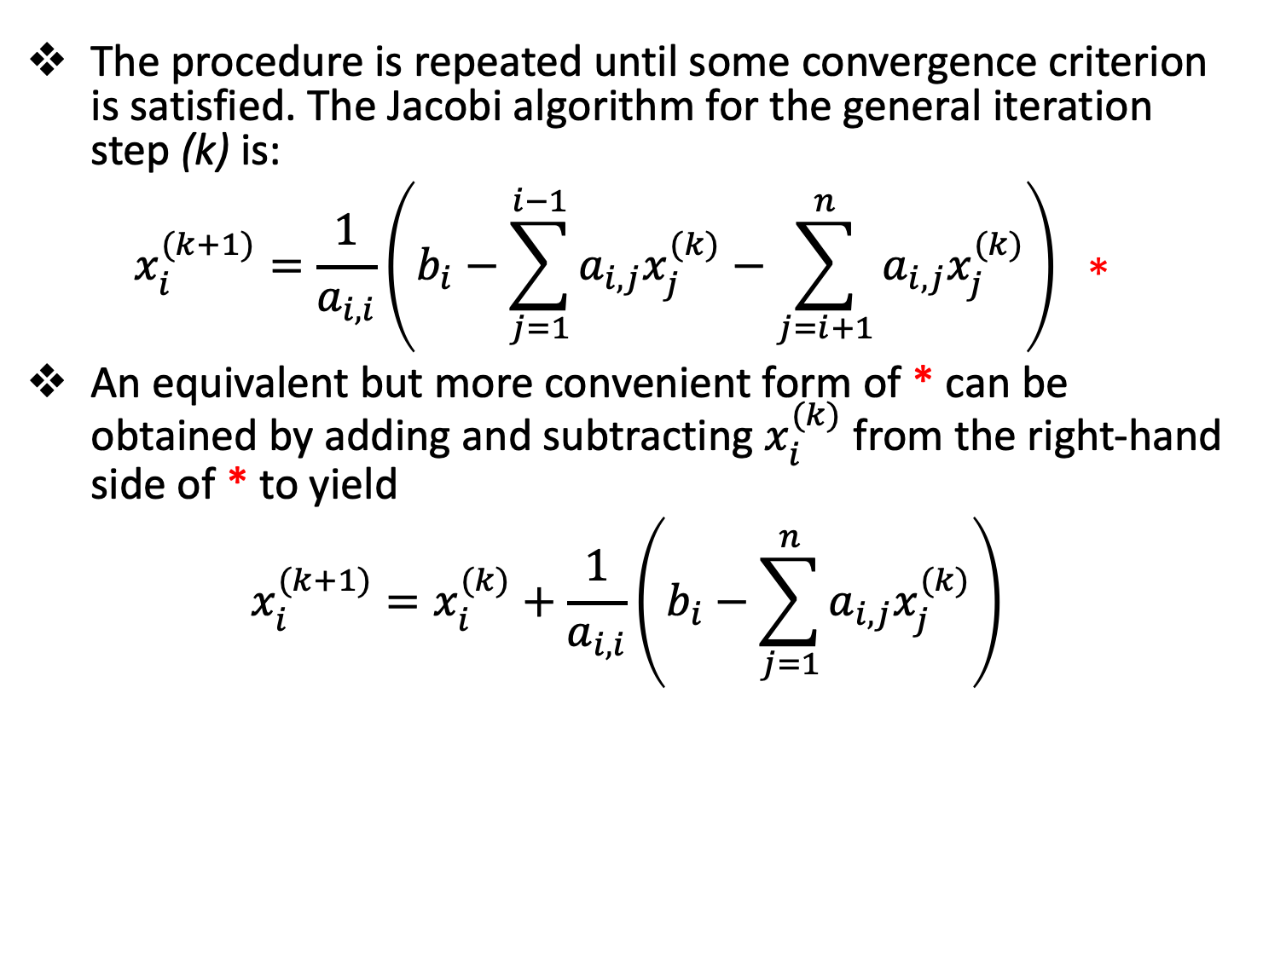
The Jacobi Iteration Method
The procedure is repeated until some convergence criterion is satisfied. The Jacobi algorithm for the general iteration step (k) is:
$$x_{i}^{(k+1)}=\frac{1}{a_{i,i}}\left(b_{i}−\sum_{j=1}^{i−1}{a_{i,j}x_{j}^{(k)}}−\sum_{j=i+1}^{n}{a_{i,j}x_{j}^{(k)}}\right) ∗$$
An equivalent but more convenient form of * can be obtained by adding and subtracting $x_{i}^{(k)}$ from the right-hand side of * to yield
$$x_{i}^{(k+1)}=x_{i}^{(k)}+\frac{1}{a_{i,i}}\left(b_{i}−\sum_{j=1}^{n}{a_{i,j}x_{j}^{(k)}}\right)$$

Slide 38
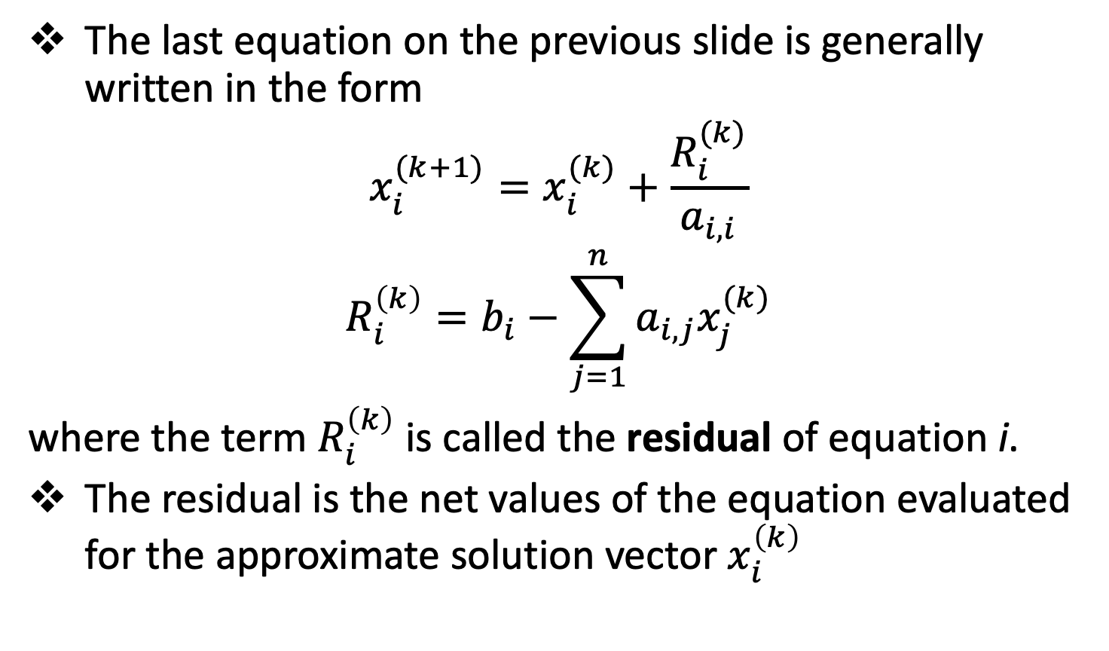
The Jacobi Iteration Method
The last equation on the previous slide is generally written in the form
$$x_{i}^{(k+1)}=x_{i}^{(k)}+\frac{R_{i}^{(k)}}{a_{i,i}}$$
$$R_{i}^{\left(k\right)}=b_{i}−\sum_{j=1}^{n}{a_{i,j}x_{j}^{(k)}}$$
where the term $R_{i}^{\left(k\right)}$ is called the residual of equation i.
The residual is the net values of the equation evaluated for the approximate solution vector $x_{i}^{\left(k\right)}$

Slide 39
The Jacobi Iteration Method - Accuracy
In iterative methods, the term accuracy refers to the number of significant figures obtained in the calculations, and the term convergence refers to the point in the iterative process when the desired accuracy is obtained.
The accuracy of any approximate method is measured in terms of the error of the method.
There are two ways to specify error: absolute error and relative error.

Slide 40
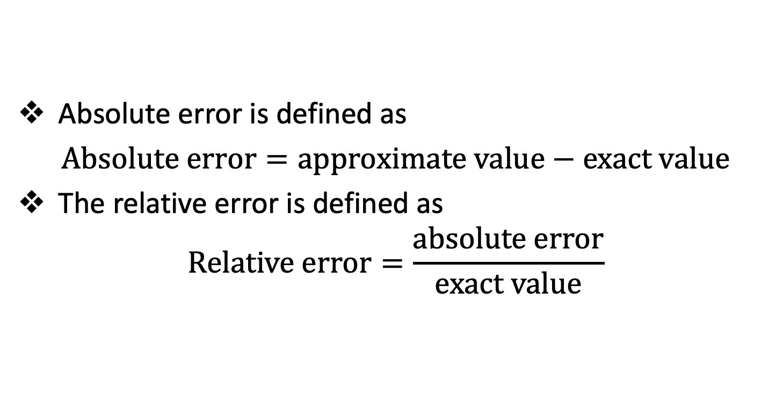
The Jacobi Iteration Method - Accuracy
Absolute error is defined as
$Absolute error=approximate value−exact value$
The relative error is defined as
$$Relative error=\frac{absolute error}{exact value}$$

Slide 41
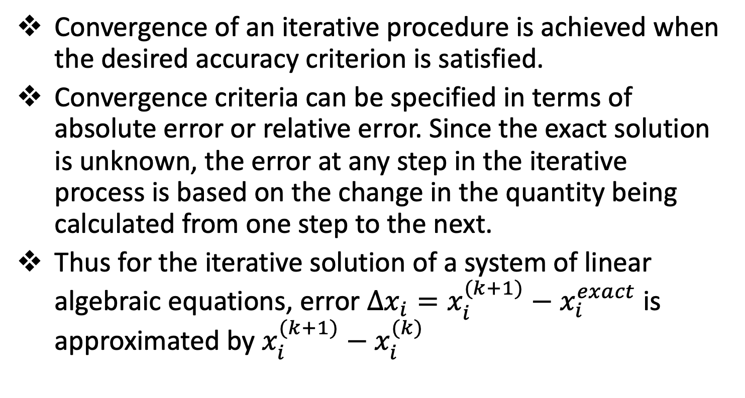
The Jacobi Iteration Method - Convergence
Convergence of an iterative procedure is achieved when the desired accuracy criterion is satisfied.
Convergence criteria can be specified in terms of absolute error or relative error. Since the exact solution is unknown, the error at any step in the iterative process is based on the change in the quantity being calculated from one step to the next.
Thus for the iterative solution of a system of linear algebraic equations, error $Δx_{i}=x_{i}^{(k+1)}−x_{i}^{exact}$ is approximated by $x_{i}^{(k+1)}−x_{i}^{(k)}$

Slide 42
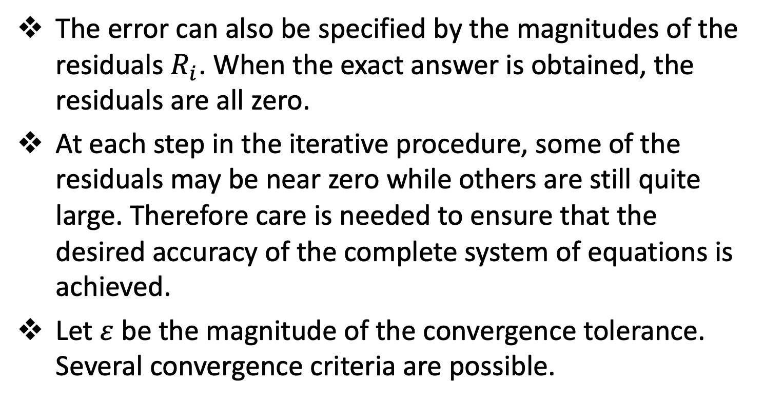
The Jacobi Iteration Method - Convergence
The error can also be specified by the magnitudes of the residuals $R_{i}$. When the exact answer is obtained, the residuals are all zero.
At each step in the iterative procedure, some of the residuals may be near zero while others are still quite large. Therefore care is needed to ensure that the desired accuracy of the complete system of equations is achieved.
Let $ε$ be the magnitude of the convergence tolerance. Several convergence criteria are possible.

Slide 43
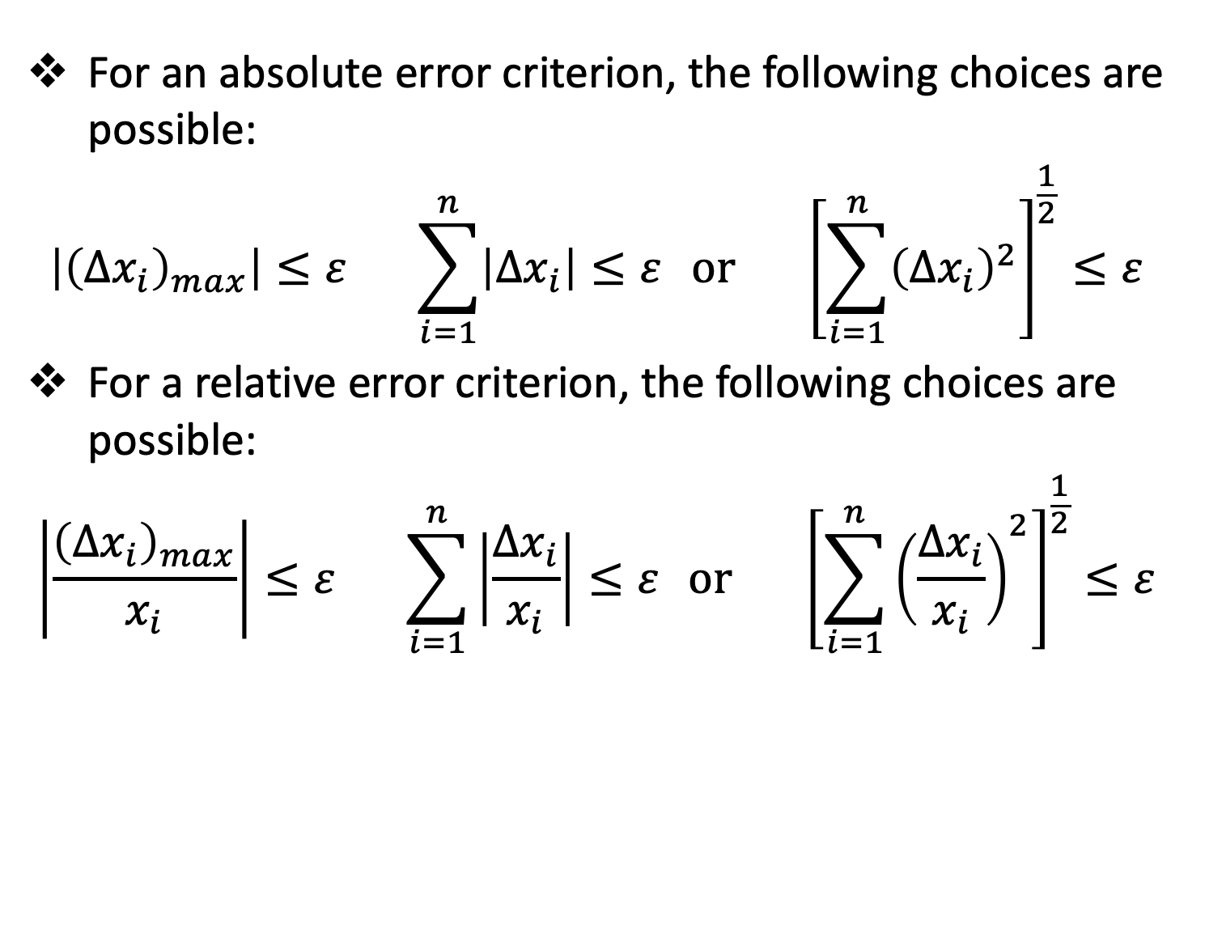
The Jacobi Iteration Method - Convergence
For an absolute error criterion, the following choices are possible:
$$\left|{\left(Δx_{i}\right)}_{max}\right|≤ε \sum_{i=1}^{n}{\left|Δx_{i}\right|≤ε} or { \left[\sum_{i=1}^{n}{{\left(Δx_{i}\right)}^{2}}\right]}^{\frac{1}{2}}≤ε$$
For a relative error criterion, the following choices are possible:
$$\left|\frac{{\left(Δx_{i}\right)}_{max}}{x_{i}}\right|≤ε \sum_{i=1}^{n}{\left|\frac{Δx_{i}}{x_{i}}\right|≤ε} or { \left[\sum_{i=1}^{n}{{\left(\frac{Δx_{i}}{x_{i}}\right)}^{2}}\right]}^{\frac{1}{2}}≤ε$$

Slide 44
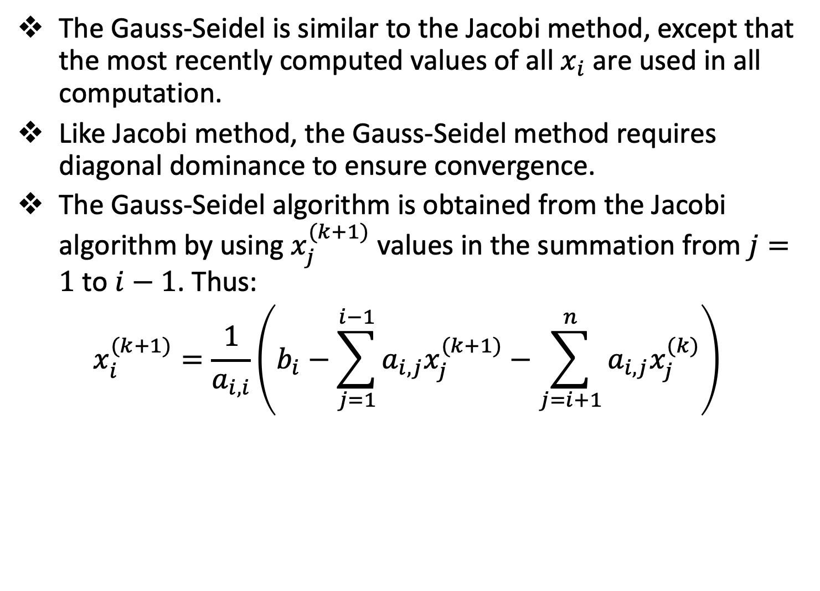
The Gauss-Seidel Iteration Method
The Gauss-Seidel is similar to the Jacobi method, except that the most recently computed values of all $x_{i}$ are used in all computation.
Like Jacobi method, the Gauss-Seidel method requires diagonal dominance to ensure convergence.
The Gauss-Seidel algorithm is obtained from the Jacobi algorithm by using $x_{j}^{(k+1)}$ values in the summation from $j=1$ to $i−1$. Thus:
$$x_{i}^{(k+1)}=\frac{1}{a_{i,i}}\left(b_{i}−\sum_{j=1}^{i−1}{a_{i,j}x_{j}^{(k+1)}}−\sum_{j=i+1}^{n}{a_{i,j}x_{j}^{(k)}}\right)$$

Slide 45
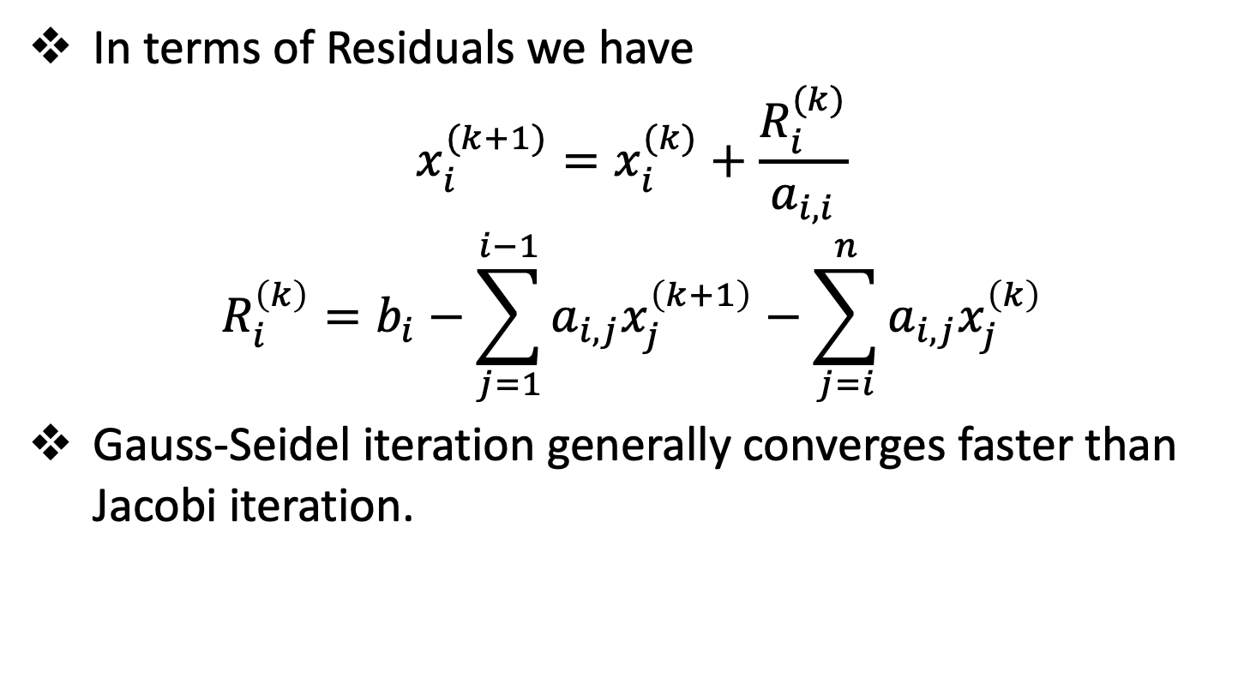
The Gauss-Seidel Iteration Method
In terms of Residuals we have
$$x_{i}^{(k+1)}=x_{i}^{(k)}+\frac{R_{i}^{(k)}}{a_{i,i}}$$
$$R_{i}^{\left(k\right)}=b_{i}−\sum_{j=1}^{i−1}{a_{i,j}x_{j}^{\left(k+1\right)}}−\sum_{j=i}^{n}{a_{i,j}x_{j}^{\left(k\right)}}$$
Gauss-Seidel iteration generally converges faster than Jacobi iteration.

Slide 46
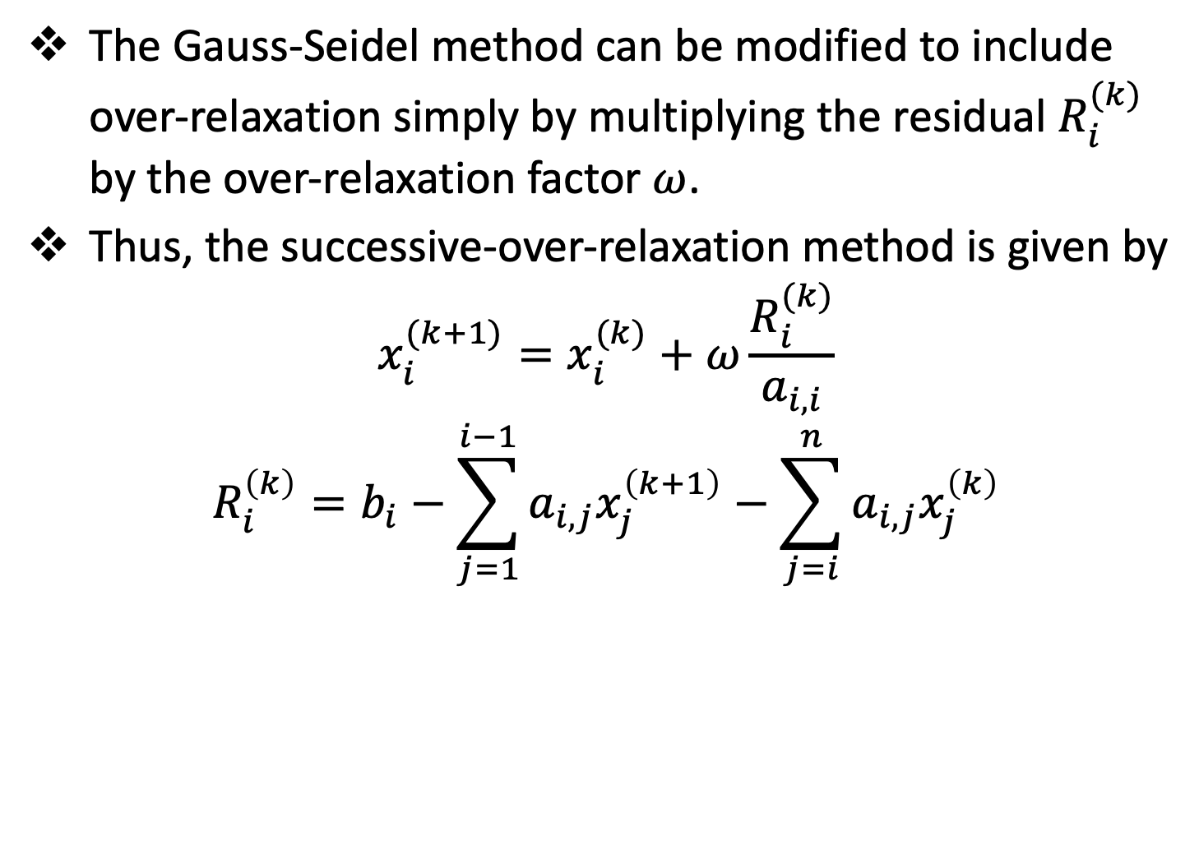
The Successive-Over-Relaxation (SOR) Method
The Gauss-Seidel method can be modified to include over-relaxation simply by multiplying the residual $R_{i}^{(k)}$ by the over-relaxation factor $ω$.
Thus, the successive-over-relaxation method is given by
$$x_{i}^{(k+1)}=x_{i}^{(k)}+ω\frac{R_{i}^{(k)}}{a_{i,i}}$$
$$R_{i}^{\left(k\right)}=b_{i}−\sum_{j=1}^{i−1}{a_{i,j}x_{j}^{\left(k+1\right)}}−\sum_{j=i}^{n}{a_{i,j}x_{j}^{\left(k\right)}}$$

Slide 47
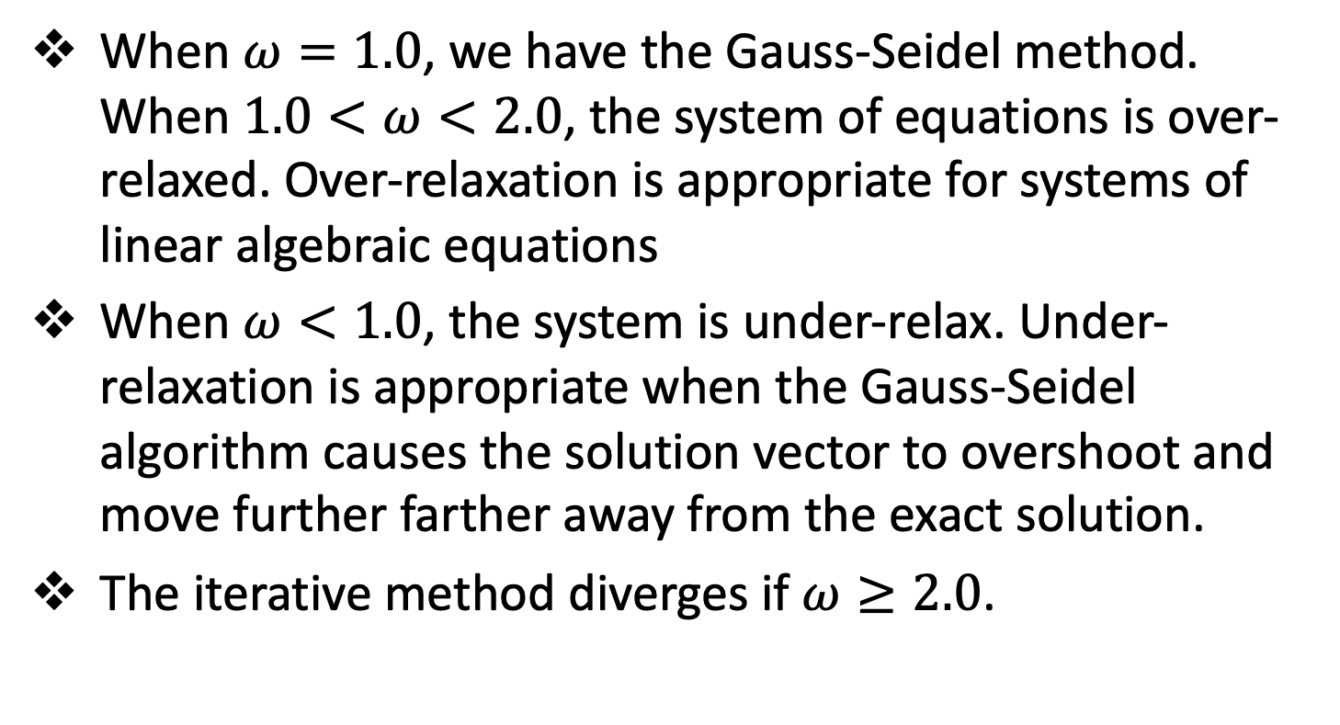
The Successive-Over-Relaxation (SOR) Method
When $ω=1.0$, we have the Gauss-Seidel method. When $1.0<ω<2.0$, the system of equations is over-relaxed. Over-relaxation is appropriate for systems of linear algebraic equations
When $ω<1.0$, the system is under-relax. Under-relaxation is appropriate when the Gauss-Seidel algorithm causes the solution vector to overshoot and move further farther away from the exact solution.
The iterative method diverges if $ω≥2.0$.

Slide 48
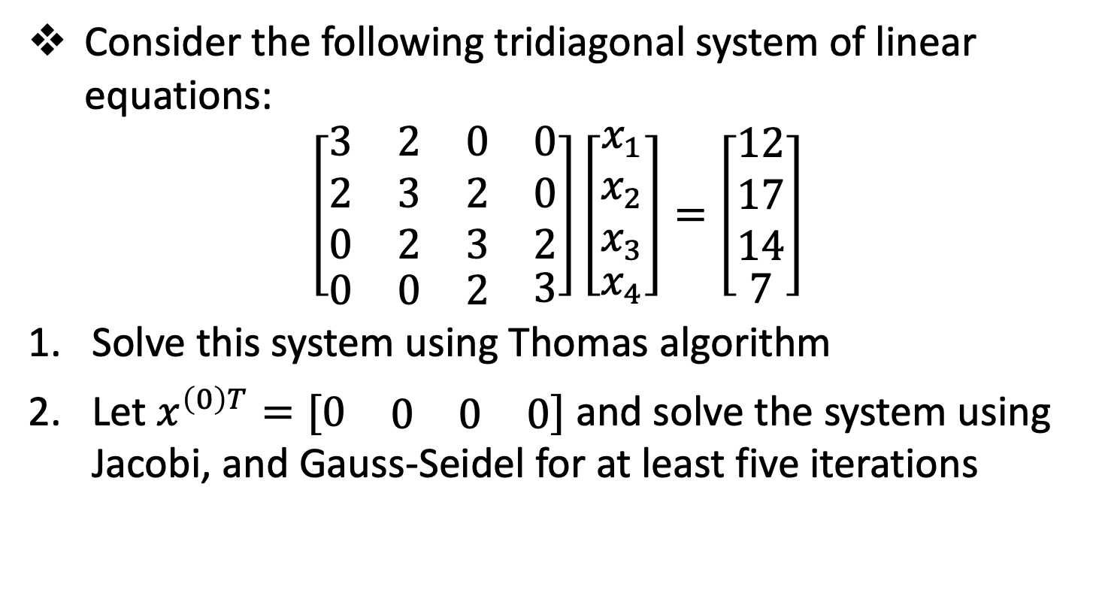
Session 2 - Assignment
Consider the following tridiagonal system of linear equations:
$$\left[\begin{matrix}\begin{matrix}3 & 2 & 0 \\ 2 & 3 & 2 \\ 0 & 2 & 3\end{matrix} & \begin{matrix}0 \\ 0 \\ 2\end{matrix} \\ \begin{matrix}0 & 0 & 2\end{matrix} & 3\end{matrix}\right]\left[\begin{matrix}\begin{matrix}x_{1} \\ x_{2} \\ x_{3}\end{matrix} \\ x_{4}\end{matrix}\right]=\left[\begin{matrix}\begin{matrix}12 \\ 17 \\ 14\end{matrix} \\ 7\end{matrix}\right]$$
Solve this system using Thomas algorithm
Let $x^{\left(0\right)T}=[\begin{matrix}0 & \begin{matrix}0 & 0 & 0\end{matrix}\end{matrix}]$ and solve the system using Jacobi, and Gauss-Seidel for at least five iterations

Slide 49
Reference
Hoffman, J. D. (2001), Numerical Methods for Engineers and Scientists (2nd Edition)
Johnston, R. L. (1982), Numerical Methods, A Software Approach, John Wiley & Sons
Kahaner, D., Moler, C., and Nash S. (1989), Numerical Methods and Software, Prentice Hall.

Slide 50
The End

